Slide 1
Sequencing
By Katie Visaggio
RED 6544
Nov. 10, 2010

Slide 2
Sequencing
Key Component to Emergent Literacy
Sense of Order to Stories
Base for Summarizing
Opportunities for Rereading & Retelling

Slide 3
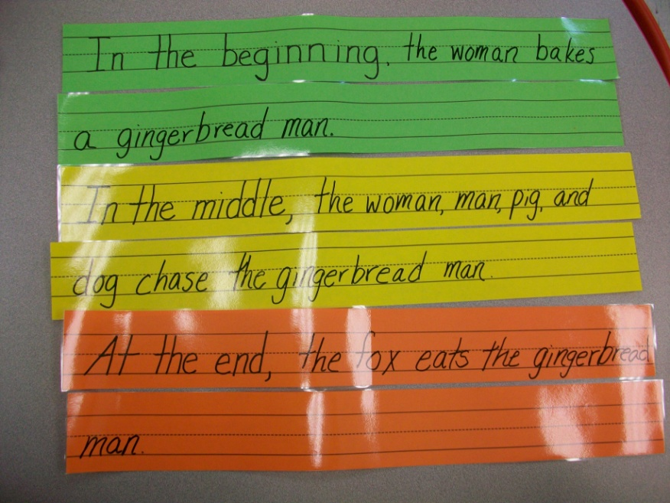
Sequencing Stories
Objectives
Identify beginning, middle, and end of story
Correctly order events to match story
Aides in retelling
Provides base for story element/structure study later in school
Helps young children start to write stories in a clear order
Assessment
Observation
Story maps/science charts
Flip books
Retelling

Slide 4
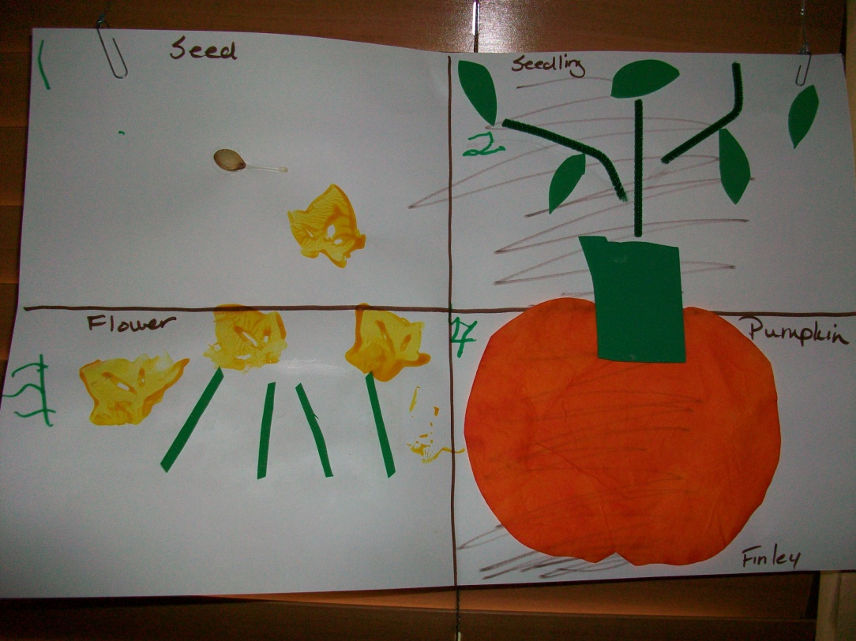
Sequencing in a preschool setting
One-on-One, small group, or whole class
With fiction stories
As retell on 3rd-5th days of a story
With nonfiction
Ex. : pumpkin life cycle
Materials:
Picture cards
Story book pages
Manipulatives
Sequencing chart after a nonfiction story-The Life of a Pumpkin

Slide 5
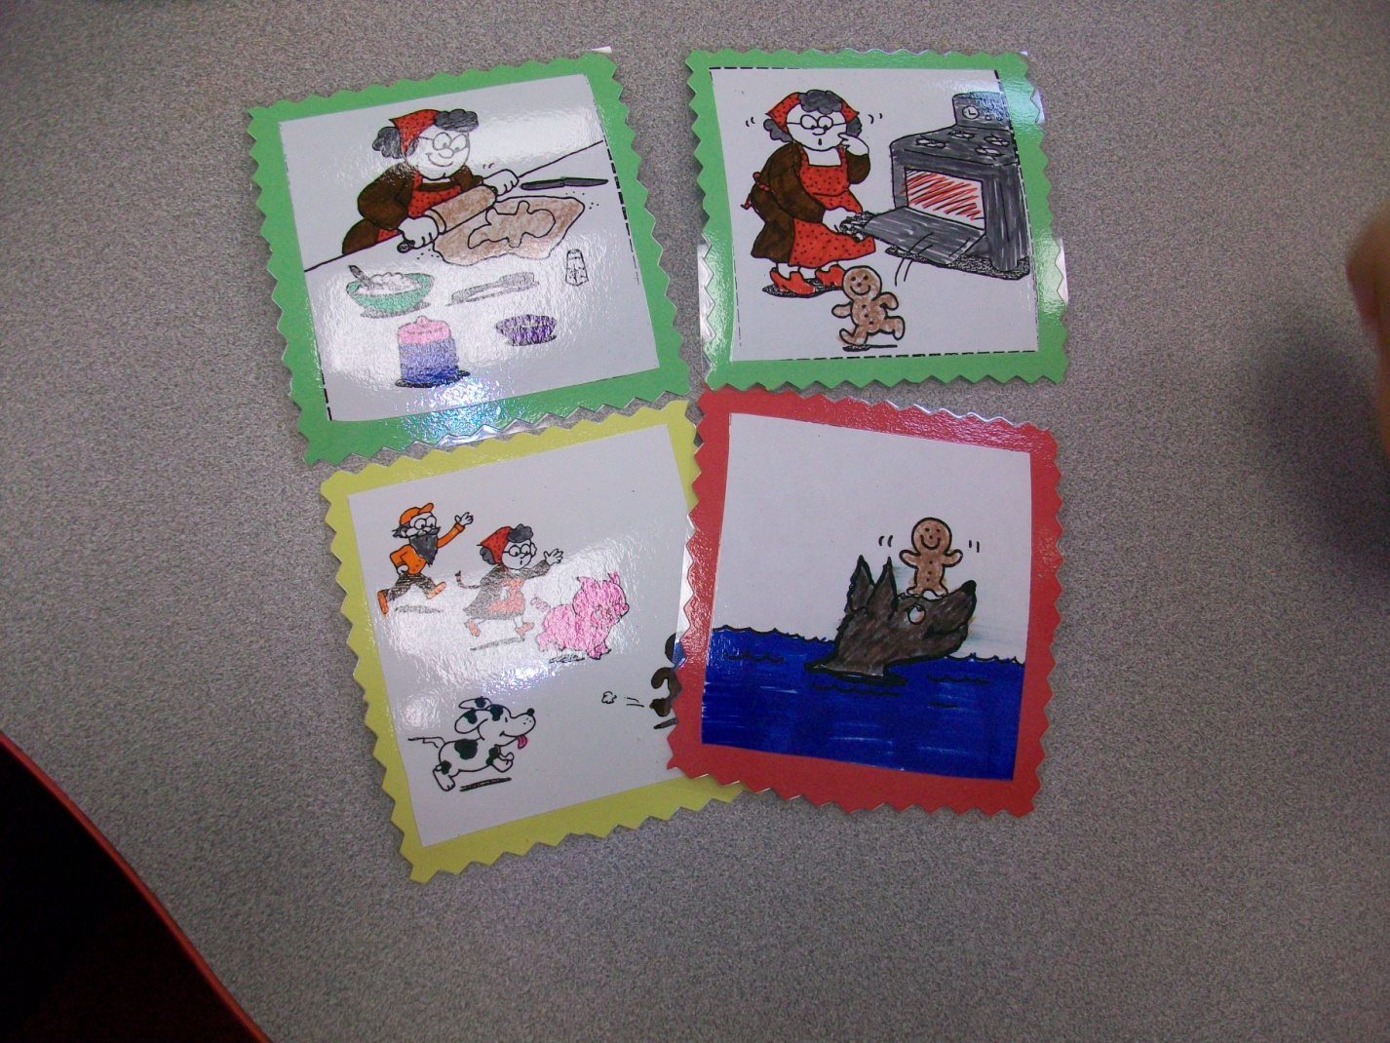
SEQUENCING
Ordering story cards and then retelling the story while I scribe on our sentence strips.

Slide 6
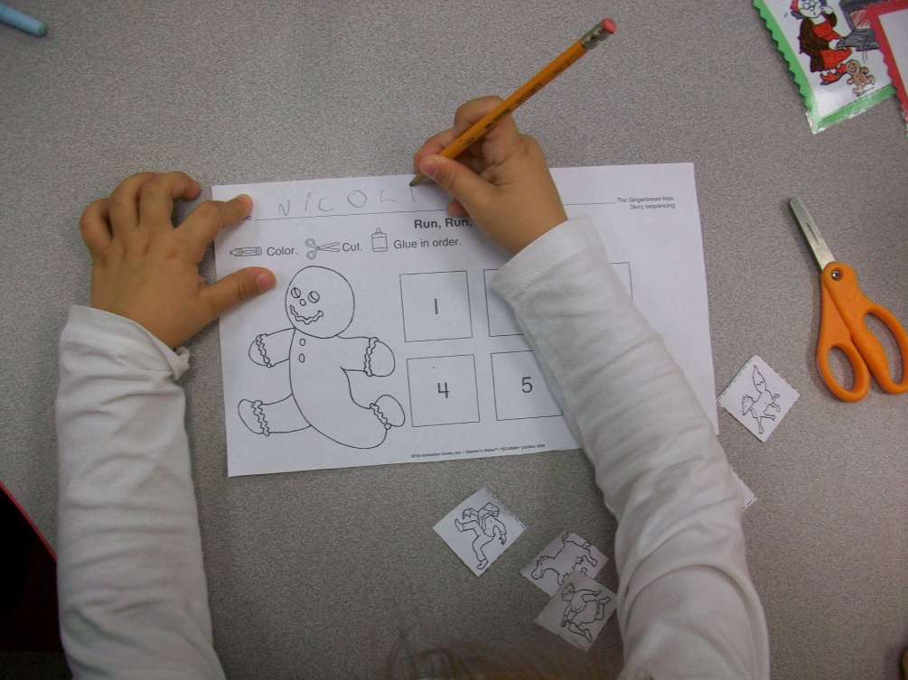
Sequencing
Teacher Vision has a great article on sequencing found here:
http://www.teachervision.fen.com/skill-builder/reading-comprehension/48779.html

